Slide 1


CO-OP Project Presentation (Module-2)
On
SAFER
Smart Alert and Fast Emergency Response
SUBMITTED BY
Raghav Kaushal
2210990699
Saransh Sharma
2210990797
Saurav Sirswal
2210990808
Karan Lamba
2210990479
SUPERVISED BY
Swati Goel
Department of Computer Science and Engineering
Chitkara University, Punjab

Slide 2
Presentation Index
01 Introduction & Objectives
02 Problem Statement
03 Technology Stack
04 Research Gaps
05 System Architecture
06 Model Performance Analysis
07 Disaster Forecasting
08 Major Findings
09 Key Features & Conclusion
3

Slide 3




Introduction to SAFER
The SAFER Portal is a sophisticated disaster response system designed to reduce the impacts of natural catastrophes through real-time data availability.
Live Updates
Earthquakes, Cyclones, and Floods.
AI Assistance
Powered by AI and smart Chatbots.
Modern Interface
Multilingual and mobile-friendly.

Slide 4



The Problem Statement
Severity & Frequency
Increasing natural disasters attributed to climate change and urbanization require proactive strategies.
Slow Data Refresh
Existing platforms suffer from fragmented response efforts and delayed emergency coordination.
Poor Engagement
Conventional disaster websites lack interactive elements and real-time public communication.

Slide 5


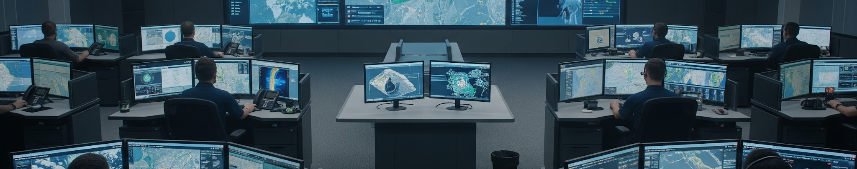
Core Project Objectives
Swift Dissemination
Multi-channel alerting via SMS, email, and push notifications to vulnerable populations.
Mobile-accessible and interactive reporting enabled for user-friendly engagement.
Coordination Hub
Centralized emergency phonebook, hospital directory, and relief material tracking.
Predictive analytics through AI to track disaster trends and improve preparedness.

Slide 6
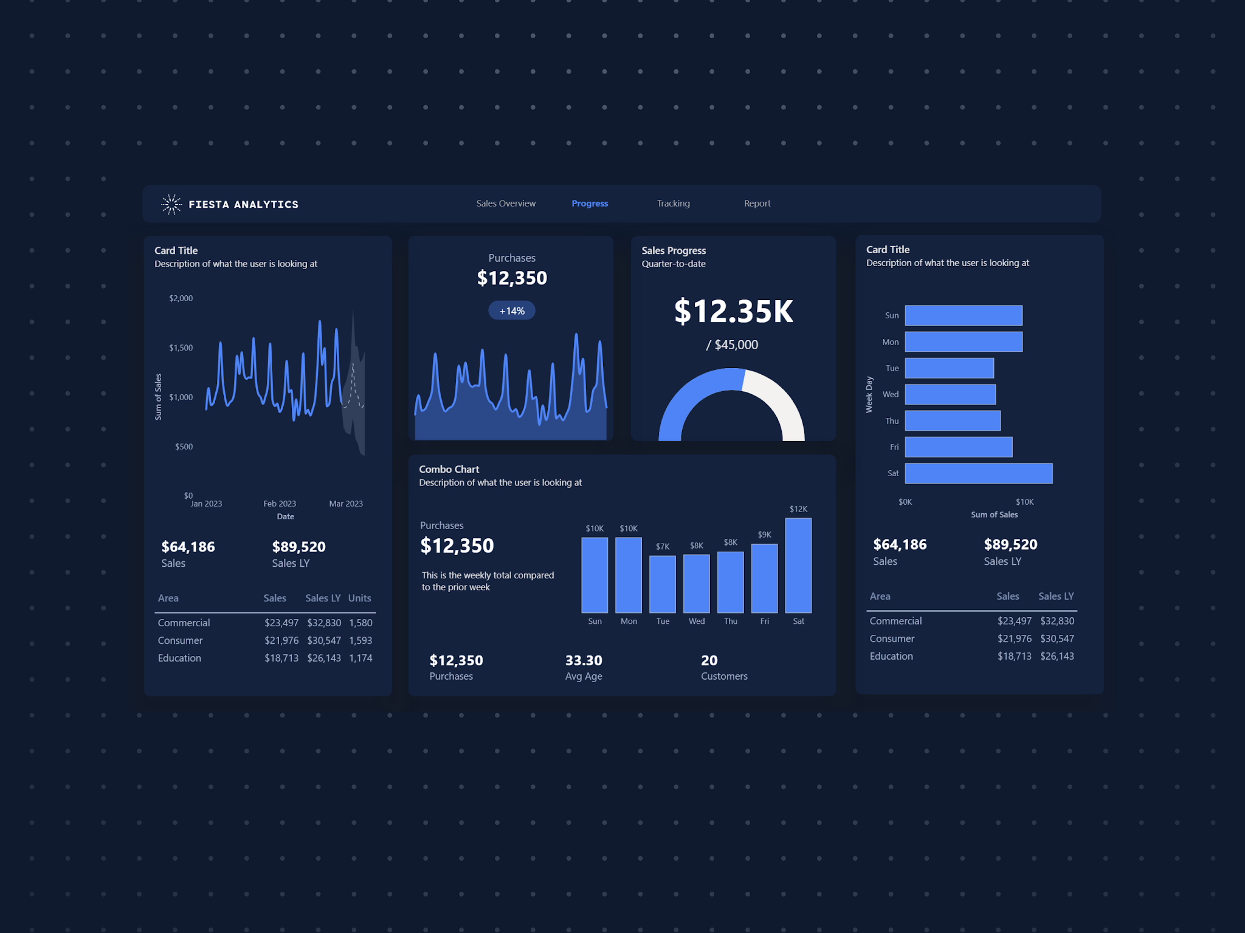


Technology Stack
Frontend & Integration
HTML5 & CSS3 (UI/UX)
JavaScript (Interactive Elements)
Automated Data Harvesting APIs
AI & Data Science
Pandas & NumPy (Processing)
Matplotlib & Seaborn (Viz)

Slide 7




Research Gap Analysis
Van Niekerk (2006)
Lack of clarity in DRR/DM terminologies and sectoral collaboration.
Wen et al. (2023)
Limited integration of DRR and Climate Change Adaptation (CCA).
Shi et al. (2020)
Need for standardized disaster risk assessment methodologies.
Najafi et al. (2024)
Computational efficiency challenges in high-res flood simulations.

Slide 8





System Workflow
Data Collection
Government reports & user queries integrated.
Data Storage
Structured DB for hospitals & contacts.
Alert Gen
General Advisory vs. Emergency Alerts.
User Portal
Chatbot interaction & live alerts display.
Feedback
Store feedback to improve system response.

Slide 9
Performance Metric Comparison
Model
R² (Test)
MAE
RMSE
R² (Train)
Linear Regression
-7.086
9.56
10.12
0.722
Polynomial (deg-2)
-2.246
5.60
6.41
0.798
Random Forest
-6.443
9.04
9.71
0.930
Gradient Boosting
-6.403
9.01
9.68
1.000

Slide 10
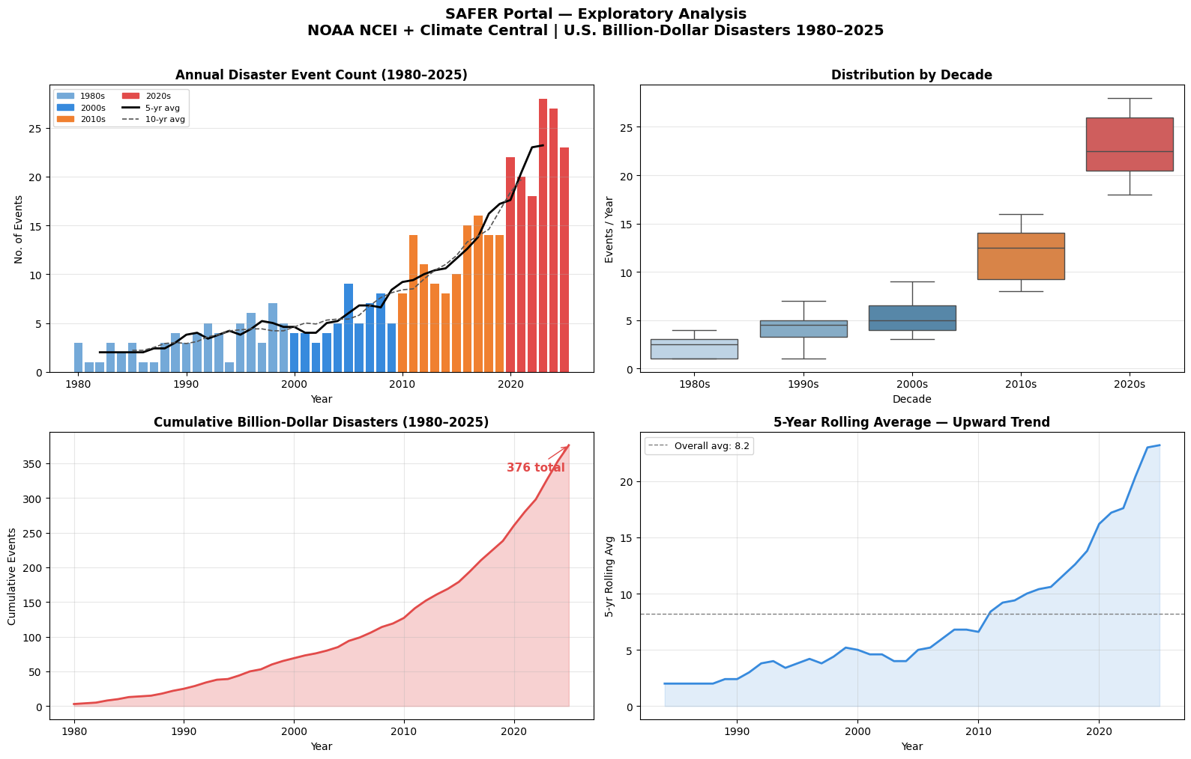
Exploratory Data Analysis (EDA)

Slide 11





Proposed Workflow Process
Fetch Data
Meteorological & Government Reports
Chatbot AI
Human-centric Situational Awareness
Generate Alert
Severity-based Classification
Display Portal
Web & Multi-channel Broadcast
Analyze
Continuous Feedback Loop Improvement

Slide 12
Ensemble Disaster Forecast
Projected Annual Billion-Dollar Disasters (2026-2031)
Year
Linear
Polynomial
Random Forest
ENSEMBLE AVG
2026
2027
2028
2029
2030
2031
14.6
14.9
15.3
15.6
16.0
16.3
20.4
21.3
22.3
23.3
24.3
25.3
14.0
13.9
14.0
13.9
13.9
14.0
15.8
16.1
16.3
16.9
17.0
17.4

Slide 13
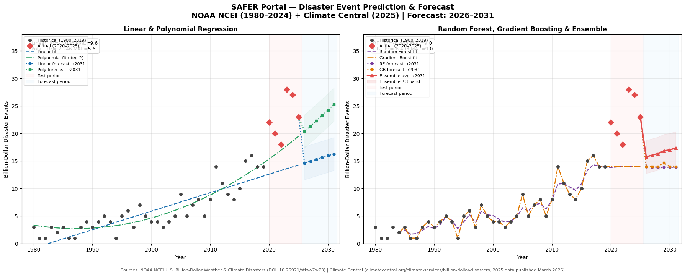
Main Prediction Chart

Slide 14
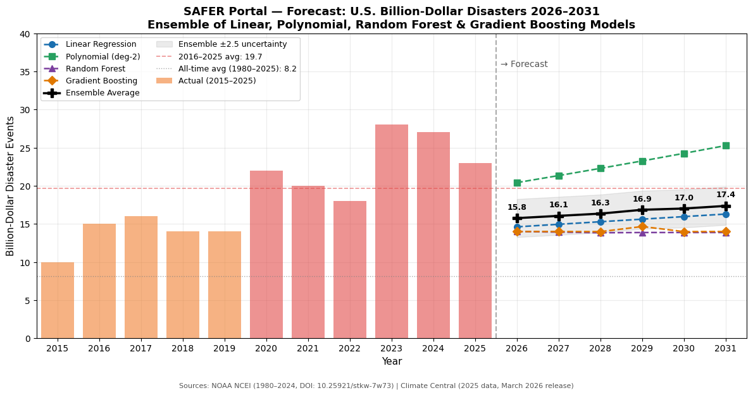
Forecast Summary Chart (2026–2031)

Slide 15
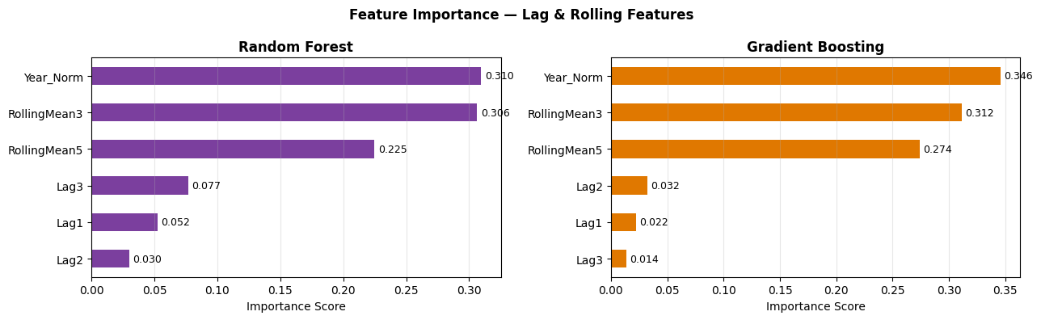
Feature Importance (Random Forest & Gradient Boosting)

Slide 16
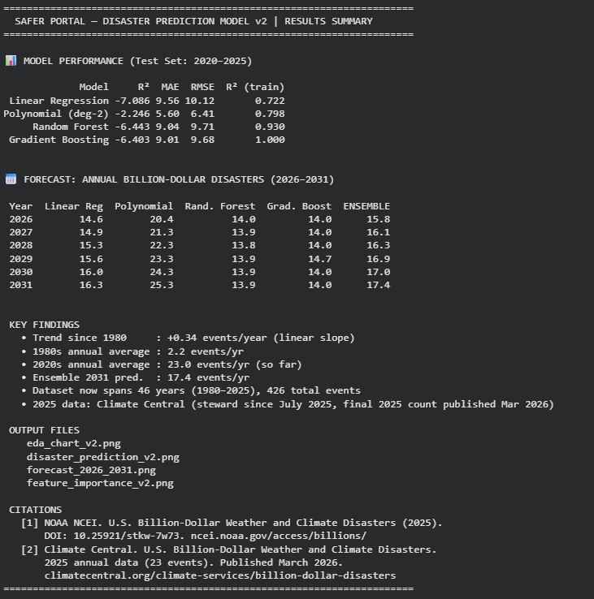
Final Model Comparison & Results Summary

Slide 17
Conclusion
Thank You

